Slide 1
Dashboard Tasks
Read Through
1. Total Crimes:
- Sum of all reported crimes in the dataset.
2. Crime Distribution by Year and Yearly Changes:
- Analysis of crimes categorized by year, including insights into the year-over-year changes.
3. Crimes by Time Range (e.g., 3:00 AM to 5:59 AM):
- Exploration of crime occurrences within specific time intervals, providing a detailed breakdown.
4. Hitmap Showing Crime Distribution by Weekdays and Months:
- Visualization using a hitmap to illustrate how crimes are distributed across weekdays and months.
5. Crimes by Country:
- Examination of crimes categorized by the country where they occurred.

Slide 2
Dashboard Tasks
Read Through
6. Total Resolved and Unresolved Crimes:
- Distinction between resolved and unresolved crimes, offering an overview of the overall resolution rate.
7. Monthly Crime Trend with Percentage Variance:
- Analysis of the monthly crime trend, accompanied by the percentage variance to highlight fluctuations.
8. Identification of the Most Dangerous Time of the Day:
- Exploration to pinpoint the specific time periods during the day associated with a higher frequency of crimes.

Slide 3
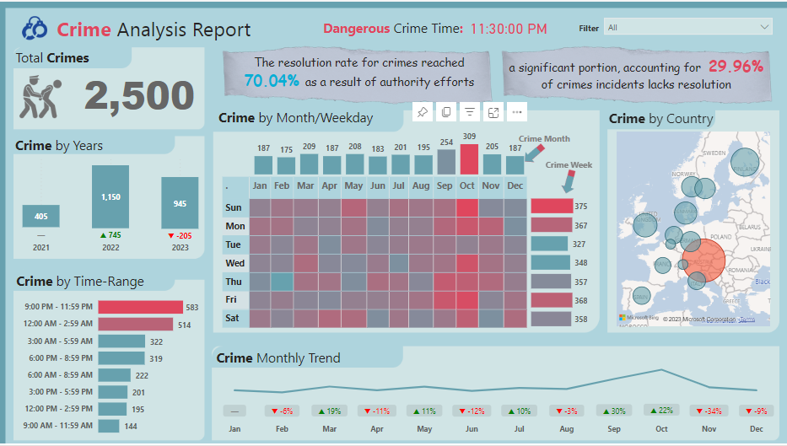

Slide 4
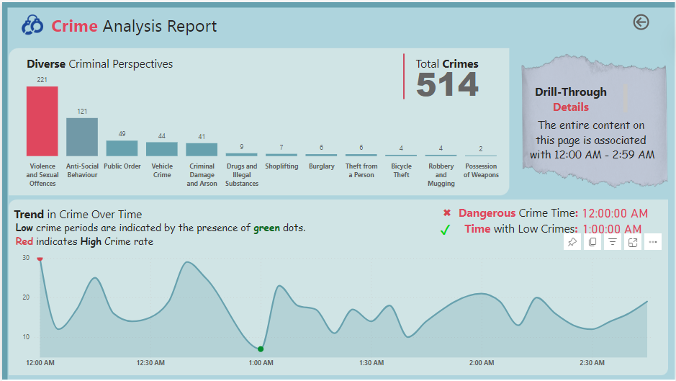

Slide 5
Used Colors

Slide 6
Subscribe
and Let’s get Started 👍

Slide 7




